Slide 1
Diversity Maximization Under Matroid Constraints
Date : 2013/11/06
Source : KDD’13
Authors : Zeinab Abbassi, Vahab S. Mirrokni,
Mayur Thakur
Advisor : Dr.Jia-ling, Koh
Speaker : Shun-Chen, Cheng

Slide 2
Outline
Introduction
Preprocessing for Clustering
Greedy Algorithm
Combined Heuristic
Diversity Maximization under Matroid Constraints
Local Search Algorithm
Experiment
Conclusions

Slide 3
Introduction
Aggregator websites typically present documents in the form of representative clusters.
Diversity
average dissimilarity among documents
differentiate category
combine the above two diversification concepts by modeling the latter approach as a (partition) matroid constraint, and study diversity maximization problems under matroid constraints.

Slide 4
Introduction
Diversity Maximization Problems
d1
d2
d3
d4
d5
d6
c1
Clustering
Query
c2
c3
Result list
Clustered Result list
pairwise distance function l： D × D
The simplest version of the diversity maximization problem is to choose a set S of k documents with maximum diversity

Slide 5
Introduction
C1
C2
D3
D1
D6
D4
Goal
D2
D9
D11
D12
D1
D2
D11
D9
C3
D3
D8
D8
D10
D5
D6
D5
D7
D12
D7
D10
D4
p representative documents
R1
D3
D9
R2
D1
D4
D8
R3
D7
maximizing diversity

Slide 6
Outline
Introduction
Preprocessing for Clustering
Greedy Algorithm
Combined Heuristic
Diversity Maximization under Matroid Constraints
Local Search Algorithm
Experiment
Conclusions

Slide 7
Preprocessing for Clustering
Given a set of documents D and topics T, an edge-weighted bipartite graph. Edge weights noted as w(d, t)
Goal：finding a subset S = {d1 , ….. , dk} of top k center documents.
In computing the set of centers S, we aim to cover a large range of topics
Relevance_score(q,d)
d1:0.9, 0.2
d2:0.8, 0.6
d3:0.7, 0.0
d4:0.5, 0.8
d5:0.2, 0.4
t1
t2
d3
If k = 2
d2
d5
Cluster 1
S = {d1 , d2 }
d1
d4
d3
Cluster 2
Might overlap
G(D,T,E) bipartite graph

Slide 8
Preprocessing for Clustering
Ex： Q = { world cup, FIFA Ranking}
query_score(q1) = 0.8 , Tq1={ t1, t2 } , |Tq1| = 2
query_score(q2) = 0.4 , Tq2={ t2 } , |Tq2| = 1
R_s(q1,d)
R_s(q2,d)
w(d1,t1) = (0.4*0.9) = 0.36
w(d1,t2) = (0.4*0.9) + (0.4*0.2) = 0.44
w(d2,t1) = (0.4*0.8) = 0.32
w(d2,t2) = (0.4*0.8) + (0.4*0.6) = 0.68
w(d3,t1) = (0.4*0.7) = 0.28
w(d4,t1) = (0.4*0.5) = 0.2
w(d4,t2) = (0.4*0.5) + (0.4*0.8) = 0.52
w(d5,t2) = (0.4*0.2) + (0.4*0.4) = 0.24
d1:0.9, 0.2
d2:0.8, 0.6
d3:0.7, 0.0
d4:0.5, 0.8
d5:0.2, 0.4
t1
t2

Slide 9
Greedy Algorithm
Ex： k=2
Initialize：S = Φ
Iteration1 ：
Coverage( SU{d1} ) = 0.36+0.44 =0.8
Coverage( SU{d2} ) = 0.32+0.68 =1.0
Coverage( SU{d3} ) = 0.28
Coverage( SU{d4} ) = 0.2+0.52=0.72
Coverage( SU{d5} ) = 0.24
Iteration2 ：
Coverage( SU{d1} ) = 0.36+0.68=1.4
Coverage( SU{d3} ) = 0.32+0.68=1.0
Coverage( SU{d4} ) = 0.32+0.68=1.0
Coverage( SU{d5} ) = 0.32+0.68=1.0

Slide 10
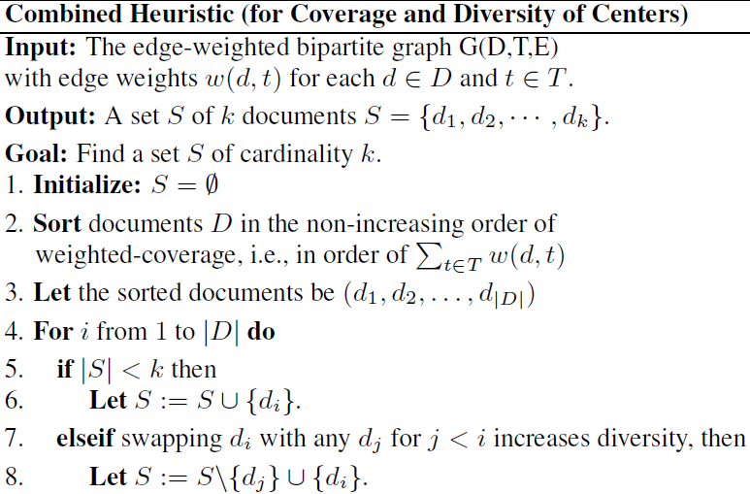
Combined Heuristic for center selection

Slide 11
Outline
Introduction
Preprocessing for Clustering
Greedy Algorithm
Combined Heuristic
Diversity Maximization under Matroid Constraints
Local Search Algorithm
Experiment
Conclusions

Slide 12
Diversity Maximization under Matroid Constraints
Starts from an arbitrary set Ri of p representative documents in each cluster.
Initialize:：Let Ri be the set of documents with the highest quality score in Ci
reliability and coverage of each document
Quality score =
popularity of owner of the micro-post
Initialize：
d3
d2
d5
Cluster 1
d5
R 1
If p = 2
d3
d1
d4
d3
Cluster 2
d1
R 2
d4

Slide 13
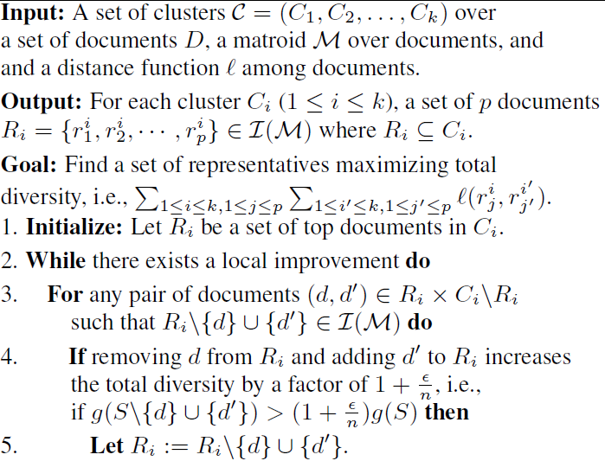
Local Search Algorithm

Slide 14
Local Search Algorithm
Ex：
R1={ d5,d3 } , R2={ d1,d4 }
Initial Diversity ( S={d5,d3,d1,d4} )
R1 × C1\R1 = { (d5,d2) , (d3,d2) }
For (d5,d2) -> R1={ d2,d3 } ->dependent
So don’t consider.
For (d3,d2) -> R1={ d5,d2 } ->independent
Diversity(S={ d5,d2,d1,d4 })
0.34 < 2 , so none action
Category 1
d3
d2
d5
Cluster 1
d1
R2 × C2\R2 = { (d1,d3) ,(d4,d3)}
For (d1,d3) -> R2={ d3,d4 } -> independent
Diversity(S={ d5,d3,d4 })
keep same , so none action
For (d4,d3) -> R2={ d1,d3 } -> dependent
So don’t consider.
d4
d3
Cluster 2
Category 1
Finished! S={d5,d3,d1,d4}

Slide 15
Outline
Introduction
Preprocessing for Clustering
Greedy Algorithm
Combined Heuristic
Diversity Maximization under Matroid Constraints
Local Search Algorithm
Experiment
Conclusions

Slide 16
Experiment
Dataset：
1)Real data - Twitter
61 families of twitter posts，each consider 10,000 to 25,000 top queries for Google real-time search
61 edge-weighted bipartite graphs with an average of 1,277 topics and average of 12,500 documents
2)Random generated data
random bipartite graphs each with 20000 documents and 2000 topics each edge is present with probability p independent of all other edges.
Consider p = 0.1% , 0.5% , 1% , 2% , 5% , 10%

Slide 17
Experiment
Metric
Weighted-coverage (W-COVERAGE)
Diversity (DIVERSITY)
Average distance to the centers (DIST-ALL)
Percentage of documents covered in clustering (PERC)
Average distance of covered documents to the centers (DISTCOVERED)
Intra-cluster diversity (INTRA-DIVERSITY)
Baseline
finding a set of centers：Sort-based Algorithm [SORT(TOP-k)]、Random Algorithm (RAND)
representative selection：picks the top p documents in each cluster [SORT(BASELINE)]

Slide 18
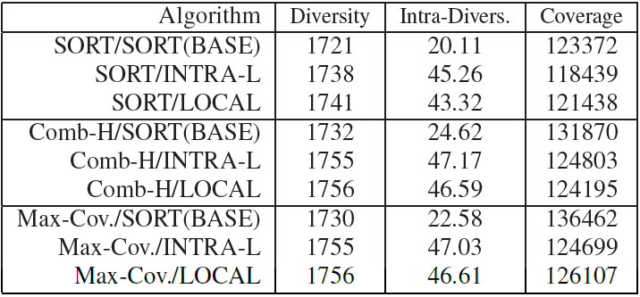
Experiment
on real data sets

Slide 19
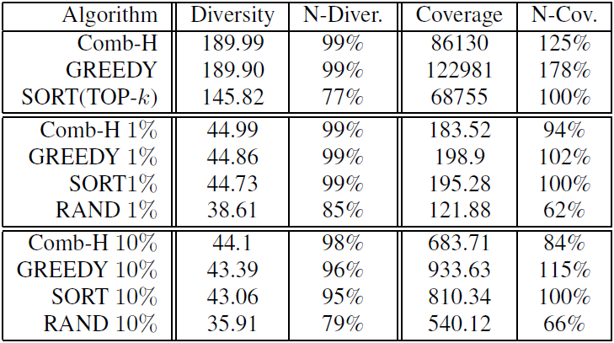
the initial set of centers various algorithms
Real data
Random data
*DIVERSITY is normalize compared to the maximum possible diversity, i.e., ,
where m is the number of documents.
*W-COVERAGE is normalized based on the coverage of the SORT algorithm.

Slide 20
User study
Amazon’s Mechanical Turk(MTurk)
four questions each question consists of two main parts: 1) Which one do you prefer?
2) Which one do you think others prefer?
each with two choices where each option is a set of clusters
Observations
65% preferred to see a more diversified set of clusters
69% thought that most people would like to see a diversified set of clusters

Slide 21
Outline
Introduction
Preprocessing for Clustering
Greedy Algorithm
Combined Heuristic
Diversity Maximization under Matroid Constraints
Local Search Algorithm
Experiment
Conclusions

Slide 22
Conclusions
study the diversity maximization problem under matroid constraints which is useful in a range of applications
present the first constant-factor approximation algorithm for this problem applying a new local search technique which implies the first constant-factor approximation algorithm for the maximum dispersion problem subject to matroid constraints

